Slide 2
How to store and handle dates
R has a built-in class "Date" to handle data entered as a date in various formats
The as.Date() function allows a variety of input formats through the format = argument
> as.Date("2013/10/15")
[1] "2013-10-15"

Slide 3
Formatting dates in R
If your input dates are not in a standard format, you can add a format string, as follows:
Code | Value
%d | Day of the month (decimal number)
%m | Month (decimal number)
%b | Month (abbreviated)
%B | Month (full name)
%y | Year (two digits)
%Y | Year (four digits)

Slide 4
Using date formats
> as.Date('9/22/1983', format = '%m/%d/%Y')
[1] "1983-09-22"
> as.Date('September 22, 1983',
format = '%B %d, %Y')
[1] "1983-09-22"
> as.Date('22SEP83', format = '%d%b%y')
[1] "1983-09-22"
> as.Date('22sep83', format = '%d%b%y')
[1] "1983-09-22"
Gracefully handles upper/lower case
R function toupper(x) converts to upper case

Slide 5
Extracting date components
Components of dates can easily be extracted, provided the items are of class PosIXt or Date
> weekdays(as.Date("2013/10/15"))
[1] "Tuesday"
> months(as.Date("2013/10/15"))
[1] "October"
> quarters(as.Date("2013/10/15"))
[1] "Q4"
> julian(as.Date("2013/10/15"),
origin=as.Date("2013/01/01"))
[1] 287
attr(,"origin")
[1] "2013-01-01"
Number of days from the start of the year

Slide 6
Sub-daily time scales
Most dates read from instruments have a finer time scale than days (hours, minutes, seconds)
For these, use the POSIXct class in R (and not the Date class)
Default input format the POSIXct class consists of the year, month, day (separated by slashes or dashes), time values may be followed by white space and a time in the form hours:minutes:seconds or hours:minutes:
1983/9/22 23:20:05
If the dates are not in this format, see help on strptime()

Slide 7
Converting to POSIXt
> as.POSIXlt("1983-9-22 23:20:05")
[1] "1983-09-22 23:20:05"
> aDate <- as.POSIXlt("1983-9-22 23:20:05")
> as.POSIXct("1983-9-22 23:20:05")
[1] "1983-09-22 23:20:05 PDT"
> aDate <- as.POSIXct("1983-9-22 23:20:05")
POSIXct includes time zone information

Slide 8
Adding and averaging dates
Many common functions can accept objects of Date class: min(), mean(), max(), ...
The difftime() function computes the difference between two time dates
> mean(c(as.Date("2013/10/15"), as.Date("2010/06/14")))
[1] "2012-02-13"
> max(c(as.Date("2013/10/15"), as.Date("2010/06/15")))
[1] "2013-10-15"
> min(c(as.Date("2013/10/15"), as.Date("2010/06/15")))
[1] "2010-06-15"
> difftime(as.Date("2013/10/15"),as.Date("2010/06/14"))
Time difference of 1219 days

Slide 9
Converting dates to factors
First create a vector of the days of the year
> everyday <- seq(from=as.Date("2013-01-01"),
to=as.Date("2013-12-31"), by="day")
> everyday
[1] "2013-01-01" "2013-01-02" "2013-01-03"...
Then convert to factors
> month <- months(everyday)
> month <- factor(month, levels=unique(month), ordered=TRUE)
> table(month)
month
January February March ...
31 28 31 ...
Number of occurrences of each item

Slide 10
Packages in R
In the homework 2, you loaded the MASS package
This contains functions and data sets from Venables & Ripley “Modern applied statistics with R”
Packages are a key feature in R, allowing users to benefit from other’s contributions
Before performing any truly arduous programming task, ask yourself whether someone else is likely to have already done that
Search for contributed packages that might already have the features you need

Slide 11
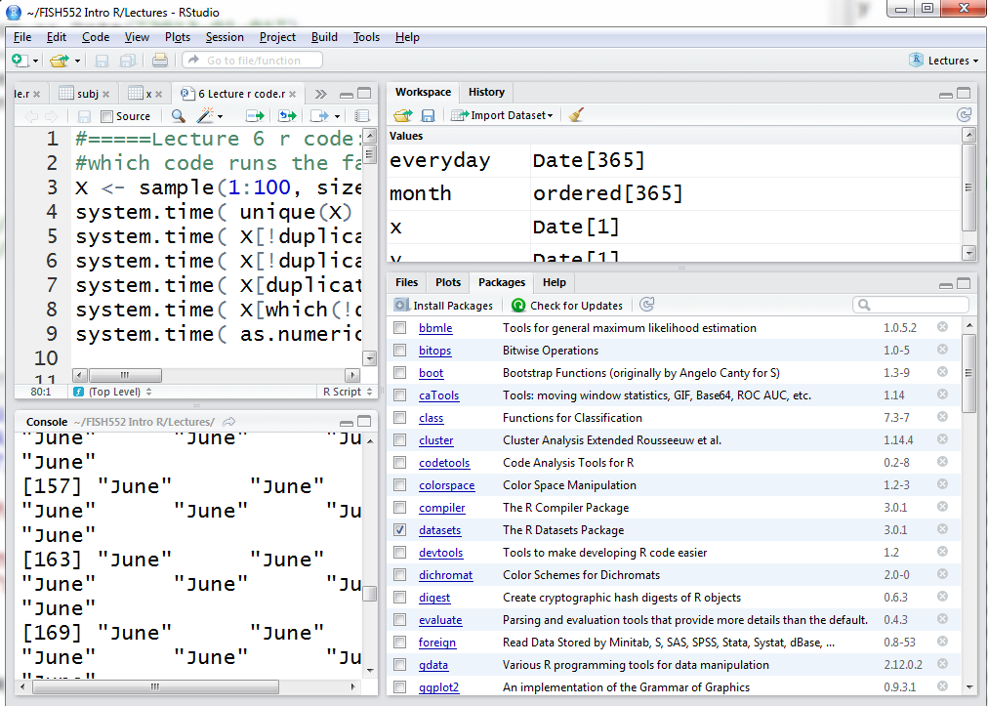
install a new package
already installed packages
Checking the box loads the package
Click on the name of the package to get a list of its functions

Slide 12
Installing and loading packages
Once a package has been installed, it needs to be loaded into R
This can be done by ticking the box next to the package
In your R code, loading is done using one of
library(package) throws error if not installed
require(package) returns FALSE if not installed (usually used inside functions)
R will return a warning if the package was compiled on a newer R version or if the version of R is incompatible with an older package

Slide 13
Finding packages
Task views http://cran.r-project.org/web/views/ that categorize packages into groups
Ask other people
Active community on Twitter use hashtag #Rstats
Search engine (also try www.rseek.org)
Scientific papers describing new methods, e.g. bathymetry plotting package marmap:
Pante E & Simon-Bouhet B (2013) PLOS ONE 8(9):e73051
Start with the most popular 100 downloaded packages: http://www.r-bloggers.com/top-100-r-packages-for-2013-jan-may/

Slide 14
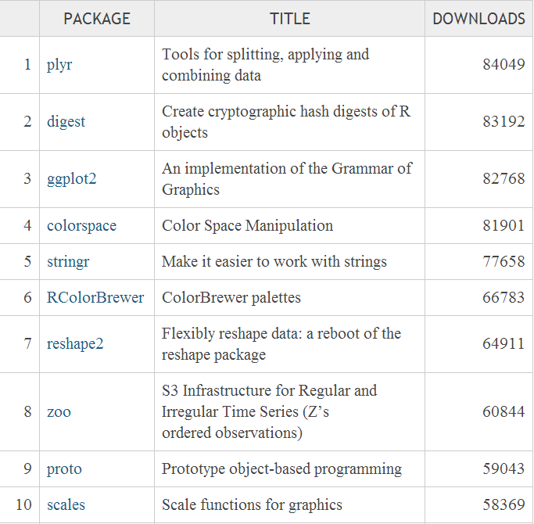
http://www.r-bloggers.com/top-100-r-packages-for-2013-jan-may/
https://www.r-bloggers.com/july-2019-top-40-r-packages/

Slide 15
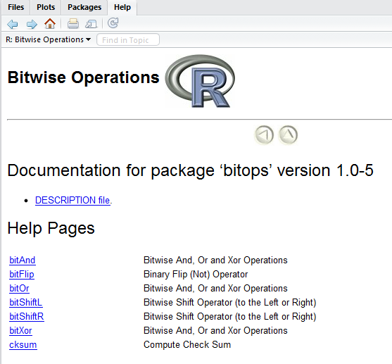
Help on packages
Click on the package for a list
of functions
You can also find vignettes
online, for example
http://cran.r-project.org/web/packages/survival/index.html
Many packages have an overview called a vignette that includes examples of the key functions
> vignette(all=FALSE)
> vignette(all=TRUE)
> vignette("googleVis")
Lists vignettes for installed and attached packages
Lists vignettes for all installed packages
Open a particular vignette

